Slide 1
CENG334 Introduction to Operating Systems Section 1

Slide 2
What is The Matrix? (also known as OS among students)
Unfortunately no one can be told what the matrix is.
You have to see it yourself!

Slide 3
Are you ready?

Slide 4
Let’s get started!
https://www.youtube.com/watch?v=vKQi3bBA1y8

Slide 5
Welcome to CENG334!
What is this course about?
Operating Systems drive the inner workings of virtually every computer in the world today
PCs, servers, iPods, cell phones, missile guidance systems, etc. all have an OS that dictate how they operate.
The OS manages many aspects of how programs run, and how they interact with hardware and the outside world.
Understanding the OS is essential for understanding:
System performance and reliability
Resource management
Virtualization and abstraction
Concurrency and parallelism
Hardware interfaces and I/O
This course is about more than just “kernel internals”
It is really about learning complex systems design.

Slide 6
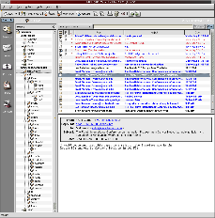
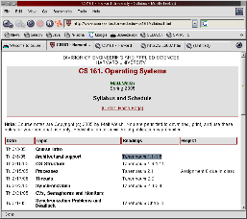
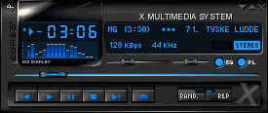
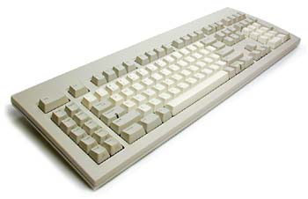
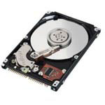
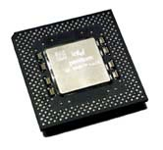
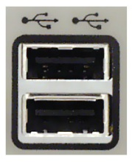
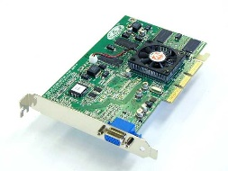
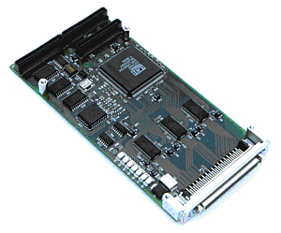
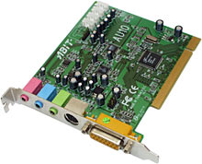
What’s an Operating System?
Software that provides an elaborate illusion to applications
User application
User application
User application
Protection boundary
Kernel
Memory management
Process management
Accounting
Filesystem
TCP/IP stack
Device drivers
Disk I/O
CPU support
Hardware/software
interface
Gnarly world of hardware

Slide 7
What’s an Operating System?
A program that acts as an intermediary between a user of a computer(ized device) and the computer(ized device) hardware.
Abstraction –
Every application thinks it has its own CPU
Every application thinks it has access to its memory space
Every application thinks it has clean/simple interface to hardware devices
Arbitration – Manages access to shared resources.
Which application should be granted CPU now?
Which application should be allocated memory?
Which application should be granted for hardware access?

Slide 8
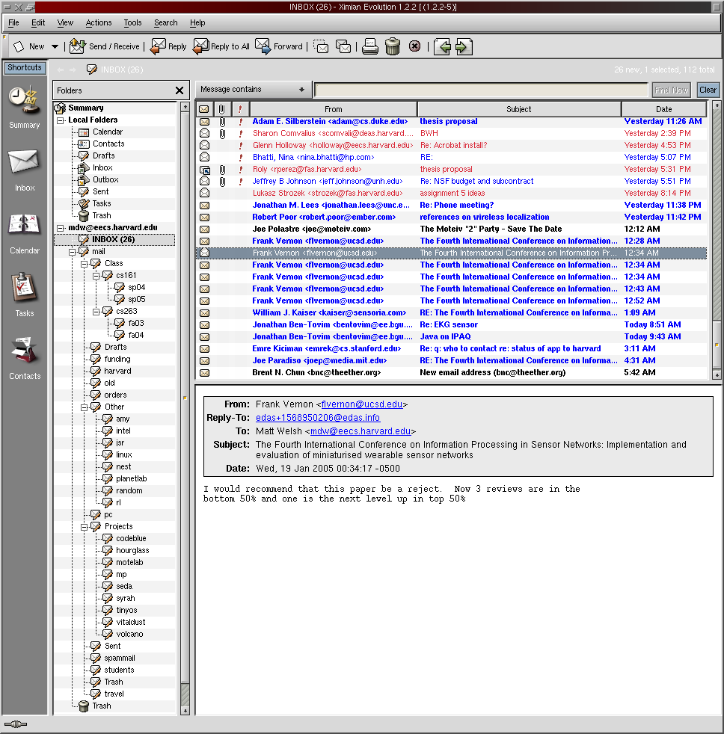
One OS Function: Concurrency
Give every application the illusion of having its own CPU!
I think I have my own CPU
So do I!

Slide 9
One OS Function: Concurrency
The OS timeslices each application on a single CPU
Switches between applications extremely rapidly, i.e., 100 times/sec
Kernel Scheduler
Timeslice on
single CPU system
time

Slide 10
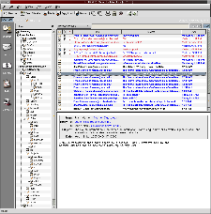
Another OS Function: Virtual Memory
Give every application the illusion of having infinite memory
And, that it can access any memory address it likes!
In reality, RAM is split across multiple applications
Physical RAM
Code
Code
Data
Data
Stack
Stack
VM System
Code
Code
Data
Data
Stack
Stack
Swap out to disk

Slide 11
More OS Functions
Multiprocessor support
Modern systems have multiple CPUs
Can run multiple applications (or threads within applications) in parallel
OS must ensure that memory and cache contents are consistent across CPUs
Filesystems
Real disks have a hairy, sector-based access model
User applications see flat files arranged in a hierarchical namespace
Network protocols
Network interface hardware operates on the level of unreliable packets
User apps see a (potentially reliable) byte-stream socket
Security and protection
Prevent multiple apps from interfering with each other and with normal system operation

Slide 12
Why bother with an OS?
Not just to give Slashdot readers something to argue about...
Abstract away messy details of hardware
Give apps a nice clean view of the system
Save programmers a lot of trouble when building applications
Allow apps to be ported across a wide range of hardware platforms
Safety!
Don't let applications run amok – keep them in a “sandbox”
e.g., Access to unallocated memory address crashes only the program, not the whole system
Segmentation fault – core dumped
Efficiency
Share one machine across many different apps: concurrent execution
You would be surprised how much slack there is in a typical computer system

Slide 13
Why study operating systems?
Most people will never write one from scratch...
(Though if you do, you stand to get incredibly rich)‏
Although more and more people are hacking them (e.g., Linux and BSD)‏
You need to understand the “big picture” in order to hack the details
This class is about much more than the kernel!
Data structures, concurrency, performance, resource management, synchronization, networks, distributed systems, databases ...
The ideas and skills you pick up in this class have broad applications
And it doesn't hurt for those Microsoft interviews either
This course is the basis for future work in other areas of systems
Distributed systems, P2P, sensor nets, etc.

Slide 14
Major OS Design Issues
Structure
How is the OS itself organized? Lots of modules? One big blob of code?
Sharing
How are limited resources multiplexed across users?
Naming
How to programs and users name and access resources?
Security
How to prevent malicious users from compromising the system?
Performance
How to keep it all fast?
Reliability
What happens when a program (or the OS itself) has a bug or failure?

Slide 15
More OS Design Issues
Extensibility
How do users and developers add new features?
Communication
How do programs exchange information?
Concurrency
How are multiple concurrent activities created and controlled?
Scale
What happens when demands on resources increase?
Distribution
How do many computers interact with each other, e.g., to pool resources?
Accounting
How do you track (and maybe charge for) resource usage?

Slide 16
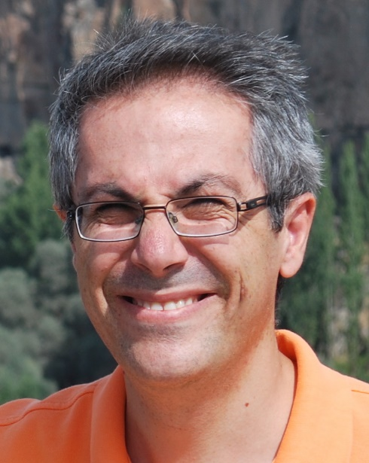
Teaching staff
Instructors:
Section 1: Dr. Erol Şahin (A-207)
E-mail: erol@ceng
Section 2: Dr. Onur Tolga Şehitoğlu (B-209)
E-mail: onur@ceng
Section 1 lectures (will be at YPA (Yüksel Proje Amfisi))
Thursdays: 11:40-13:00 @ YPA-2
Fridays: 13:40-15:00 @ YPA-3
2+2 lecture time allocated
Section 2 lectures:
Mondays: 15:40-17:20 @ BMB1
Wednesdays: 12:40-13:20 @ BMB1
Teaching assistants:
Cagri Utku Apak (A-205)
E-mail: cakpak@ceng
Deniz Sayin (A-409) **Will be unreachable till mid April**
E-mail: sayin@ceng
Notes:
16
18/02/08

Slide 17
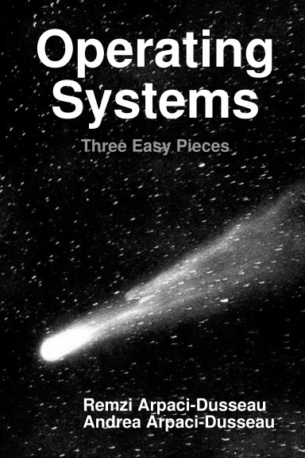
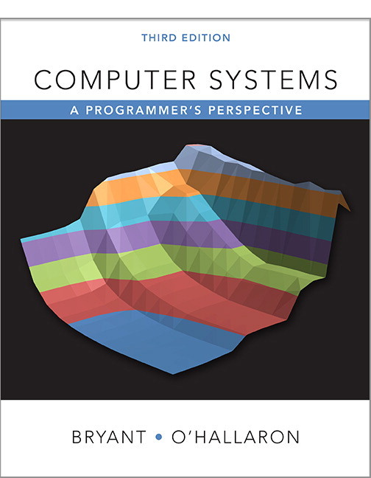
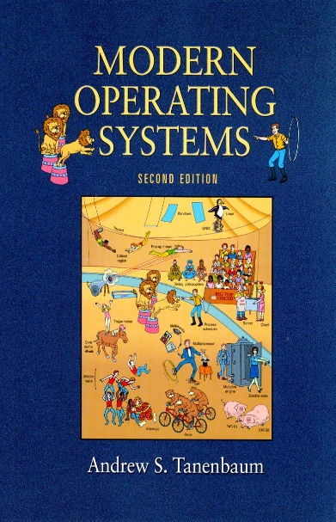
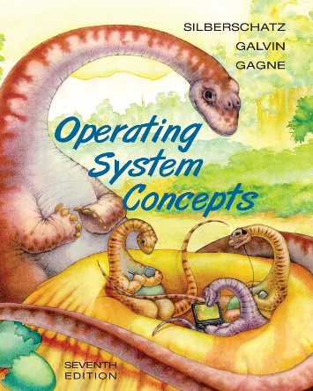
Textbook
Operating Systems: Three Easy Pieces by Arpaci-Dusseau and Arpaci-Dusseau
https://pages.cs.wisc.edu/~remzi/OSTEP/
The Little Book of Semaphores by Downey (Green Tea Press)
https://greenteapress.com/wp/semaphores/
Computer Systems: A Programmer's Perspective by Bryant and O'Hallaron.
Operating System Concepts by Silberschatz, Galvin & Gagne (Wiley)
Modern Operating Systems by Tanenbaum (Prentice Hall)
The content of the lectures (slides) will define the coverage.
Contents of the books are similar, but the presentation may differ.
Pick at your own taste, and follow the lectures.

Slide 18
Videos and other resources
Recorded lectures from 2020 [starting from 3rd week]
http://tiny.cc/o86puz
Recorded lectures from 2021
Needs editing – to remove student participations due to KVKK
Any volunteers?

Slide 19
Grading
Dates of the exams and assignments will be decided and announced later together with the instructors of other 3rd year courses to minimize overlap and conflict.
21%: Midterm I
21%: Midterm II
23%: Final Exam.
30%: Assignments.
5%: Pop quiz
Late submission penalty = 5d^2 , where d is number of days of late submission.
Students need to collect 25/100 in average from programming assignments announced before final exam (typically first two assignments). Otherwise student will not be qualified for final and graded as NA.

Slide 20
Assignments - To be decided
Assignment 1: Pipes ?
Assignment 2: Basic Threading?
Assignment 3: File System?

Slide 21
Policies
Late submission penalty : 5d²
d: the number of days of late submission
d=1 => 5% penalty
d=2 => 20% penalty
d=3 => 45% penalty
d=4 => 80% penalty
d>=5 => 100% penalty
Academic dishonesty:
All assignments submitted should be fully your own.
Your work will be regularly checked for such misconduct and any such attempts will be prosecuted:
Zero tolerance policy on cheating and plagiarism.
At all times you have the right to challenge our decisions on cheating, upon which the case will be processed through the disciplinary channels of the university. However, we would like to remind you that, if found guilty, the legal code of the university proposes a minimum of six month expulsion from the university.
Notes:
21
18/02/08

Slide 22
Cheating
What is cheating?
Sharing code: either by copying, retyping, looking at, or supplying a copy of a file.
What is NOT cheating?
Helping others use systems or tools.
Helping others with high-level design issues.
Helping others debug their code.
Notes:
22
18/02/08

Slide 23
Cheating: Caught and punished
Friend
Whole code
Easy to detect!
Partial code/ “close collaboration”
Walk on a thin line
Friend who submitted a similar homework in the previous years
Caught, since all previous homework submissions are archived
Internet
Whole code
Partial code
Notes:
23
18/02/08

Slide 24
Web page/communication
Course web page:
https://odtuclass.metu.edu.tr
All Sections: General announcements and resources for both sections
Section 1: Specific announcements for Section 1
Official announcements and discussions:
https://cow.ceng.metu.edu.tr/c/courses-undergrad/ceng334/
Questions that are general or related to content should be posted to the newsgroup.
Course conduct related questions should be posted to the instructor and/or teaching assistants in private. Make sure you include “CENG334” in the subject line

Slide 25
Course conduct - Sections
Same midterms
Same assignments
Different quizzes
Pick a section and attend it
No need to change sections
Registering to one section, but attending to another is fine..
Just be consistent..

Slide 26
Web surfing homework for next lecture..
Learn
More about XEROX PARC
What have they invented?
More about Ken Thomson and Dennis Ritchie
What are they known for?
More about Microsoft
How did MS-DOS become so successful?
More about Apple
What’s the relation between XEROX PARC GUI and Apple GUI?
What’s Slashdot?
Use Wikipedia, and google the web..

Slide 27
Movie suggestion

Slide 28
Quiz policy – Section 1
Questions about the current lecture
To check that you’ve understood the course content in that lecture
First quiz will remain open until 13:50!

