Slide 1
Feudal networks for hierarchical reinforcement learning
Google Deepmind Team:
Alexander Sasha Vezhnevetz
Simon Osindero
Tom Schaul
Nicolas Heess
Max Jaderberg
David Silver
Koray Kavukcuoglu
Çağlar Seylan

Slide 2
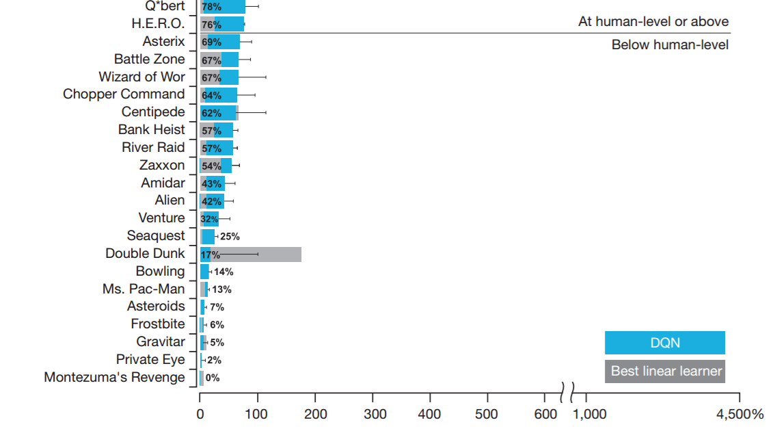
Introduction
Remember previous week’s Nature paper (Mnih etal. 2015),
Games require reactiveness rather than long-term planning.
These games are challenging in the sense that they require long-term planning along with reactiveness. The approach was not good long-term planning. That’s why scores are too low.
Notes:
The games in which high scores obtained are simple in the sense that short-term planning is sufficient in them.
The games in which low scores obtained are difficult in the sense that they require long-term planning along with short-term planning.

Slide 3
Introduction
Design of a Q-Learning managerial hierarchy consisting of managers and workers exploiting deep learning techniques.
Manager works at low temporal resolution, it sets ‘long term’ goals, i. e., strategies.
Worker works at high temporal resolution, it realizes goals set by the manager, i. e, it is a labor.
Manager receives its learning reward from the environment (extrinsic reward).
Worker receives its learning reward both intrinsically (as it achieves goals set by the manager) and extrinsically.

Slide 4
Introduction
Key Contributions
Hierarchical deep learning arch. inspired from FRL.
Semantically meaningful goals set by the manager (thanks to proposed transition polict gradient update.).
Directional goals rather than absolute (Manager finds advantageous directions that the worker should follow.).
Dilated LSTM with which the manager is able to work at lower temporal resolution.

Slide 5
Background & Related Work
Hierarchical agents in reinforcement learning framework has a long history (Dayan etal. 1993).
Options framework (Sutton etal. 1999)
- Two level hierarchy
- Bottom level called as ‘option’ or ‘sub-policy’
- Takes env. observations, generates actions
- Top level chooses an option w/ policy-over-options
- Options are learned explicitly (pseudo-rewards)
- Policy-over-options are learned using standard techniques (treating options as actions)
Notes:
- Explaining hierarchical reinforcement learning takes too much time, instead of digging into those issues I will explain important milestones in deep hierarchical reinforcement learning.

Slide 6
Background & Related Work
Option-critic architecture (Bacon etal. 2017).
- Learning options and policy-over-options simultaneously in an end-to-end fashion.
- Options shrink into only one that solves the whole task.
- Policy-over-options changing options at every step, i. e., high-level deviates from its own mission.
- Regularization techniques to keep multiple options.

Slide 7
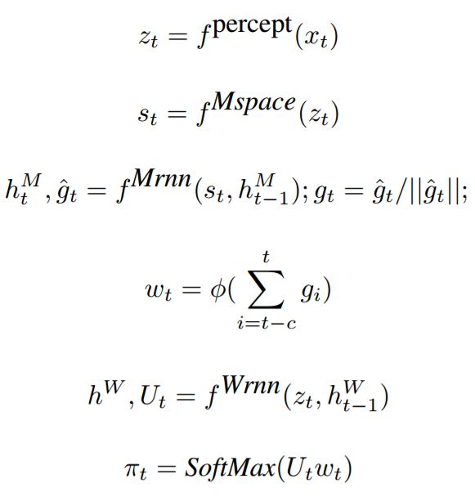
Model
$z$: Embedding of env. $x$
$h^{M}$: Internal state of manager
$h^{W}$: Internal state of worker
$g:$ Goal
$w$: Embedding of goal $g$
$c$: Prediction horizon
$U$: Output of worker
$π:$ Vector of prob. over actions
$f^{percept}$: CNN, 1st layer: 16 8x8 filters w/ stride 4, 2nd layer 32 4x4 filters w/ stride 2, fully connected layer has 256 hidden units.
$f^{Mspace}$: Fully conn. layer, computes state space.
$f^{Wrnn}$: Standard LSTM w/ 256 hidden units, computes goal.
$f^{Mrnn}$: Dilated LSTM w/ 256 hidden units (will be explained detailed later).
Notes:
In summary, worker uses goals supplied by the manager and U (holds kinda a summary of the state space) computed with fWrnn to reach an action.
Manager computes state space with fMspace and feeds fMrnn with its output to reach a goal.
fPercept is a CNN that embeds the environment into vector z.

Slide 8
Model
Learning
FuN is fully differentiable so that it can be trained end-to-end in the conventional way by grad. descent on either policy or using Temporal Difference (TD) learning.
- Then, goals generated by the manager would have no semantic meaning, they would be just values generated by optimization algorithm.
Idea is training the manager independently such that
- it will predict advantageous directions in the state space, i. e., it will set transitions or ‘strategies’.
- Reward the worker so that it will follow these directions.
Notes:
- Temporal difference learning is a prediction-based ML method, primarily used in reinforcement learning framework. It is combination of Monte Carlo and dynamic programming ideas.

Slide 9
Model
Gradient for the goal:
$$∇g_{t}={A_{t}}^{M}∇_{θ}d_{cos}(s_{t+c}−s_{t},g_{t}\left(θ\right))$$
Manager’s advantage function
$${A_{t}}^{M}=R_{t}−{V_{t}}^{M}(x_{t},θ)$$
Cos similarity, thanks to this factor, optimization process finds goals towards advantageous direction. Now the goal has a semantic meaning.
Value function estimate from internal critic
Intrinsic reward for the worker:
${r_{t}}^{I}=\frac{1}{c}\sum_{i=1}^{c}{d_{cos}(s_{t}−s_{t−i},g_{t−i})}$

Slide 10
Model
Worker’s policy $π$ is trained to maximize $R_{t}+α{R_{t}}^{I}$.
$R_{t}$: Extrinsic reward
$α$: Hyperparameter to blend intinsic and extrinsic reward
- According to experiments, blending the rewards give better results.
Worker policy gradient:
$∇π_{t}={A_{t}}^{D}∇_{θ}log⁡π(a_{t}|x_{t};θ)$
$${A_{t}}^{D}=(R_{t}+α{R_{t}}^{I}−{V_{t}}^{M}(x_{t},θ))$$
Value function estimate from internal critic

Slide 11
Model
Transition Policy Gradients
Consider $o_{t}=μ(s_{t},θ)$
$μ(.)$: High-level policy selecting among subpolicies
$o$: Sub-policy
Transition policy:
$$π^{TP}\left(s_{t+c} | s_{t}\right)=p(s_{t+c}|s_{t},μ(s_{t},θ))$$
Distribution of states we end up given initial state and selected sub-policy
Transition policy gradient:
$$∇_{θ}{π_{t}}^{TP}=𝔼\left[\left(R_{t}−V\left(s_{t}\right)\right)∇_{θ}\log{p(s_{t+c}|s_{t},μ(s_{t},θ))}\right]$$
It is assumed that,
$p(s_{t+c}|s_{t},μ(s_{t},θ))∝e^{d_{cos}(s_{t+c}−s_{t},g_{t})}$ (von Mises-Fisher distribution)
- This means we have knowledge of where the trajectories are likely to end up. By using this, we can skip over the worker’s behaviour and directly follow the policy gradient of the predicted transition.

Slide 12
Model
Dilated LSTM (dLSTM)
Allows manager to work at lower temporal resolution.
Full state of the network is composed of $r$ (mutually exclusive) sub-states.
Sub-state with index $t mod r$ is selected.
Formally,
$$h={{\{{\hat{h}}_{}^{i}\}}_{i=1}}^{r}$$
$${{\hat{h}}_{t}}^{t mod r},g_{t}=LSTM(s_{t},{{\hat{h}}_{t−1}}^{t mod r};θ^{LSTM})$$
This means only a part of the state is updated at each moment leaving other sub-states intact.
Recall that output is pooled across the prediction horizon:
$w_{t}=φ(\sum_{i=t−c}^{t}{g_{i}})$
- This implies dLSTM preserves memory for a long time.
- At the same time, learns from every new experience.

Slide 13
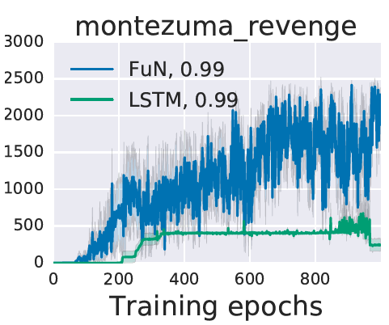
Experiments
Montezuma’s Revenge
A challenging game in the sense that it requires long-term planning and the rewards are sparse.
$$γ_{LSTM}=0.99$$
$$γ_{FuN,W}=0.99$$
$$γ_{FuN,M}=0.999$$
Encourages long-term planning
FuN learns earlier and gets higher scores as the training progresses.

Slide 14
Experiments
Other Atari Games
FuN with high manager discount factor outperforms the other methods.
This is expected because the five games require long term planning and low manager discount factor encourages long-term planning.
* BPTT in FuN is 400.

Slide 15
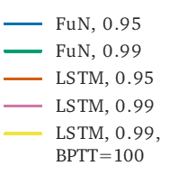
Experiments
In these set of games, FuN and LSTM performs equally or LSTM outperforms FuN.
These games do not require setting long-term strategies, rather they require reactiveness and good reflexes.
We can infer that, FuN is not the best choice for the tasks requiring only short-term planning.

Slide 16
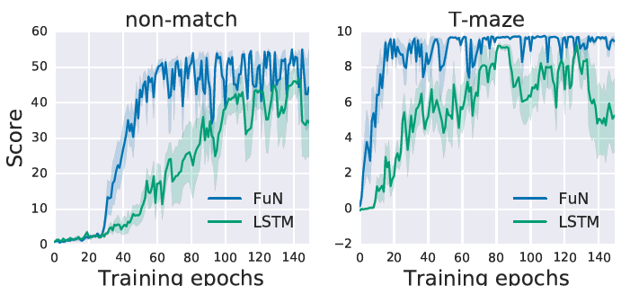
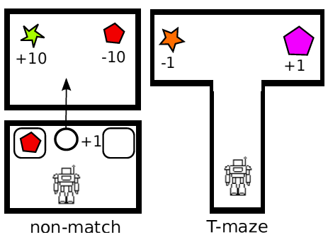
Experiments
Memory in Labyrinth
To test visual memory (DeepMind Lab, 3D game platform with first-person view like from an eye of a human.).
FuN outperforms LSTM in these tasks.
Notes:
In non-match task we start in a room with two bell glasses. There is an unreachable object in on of the bell glass. Then we are teleported into another room in which there are two rewards, one gives 10 points and the other gives -10 points. The one that is different than in the first room should be selected.
In T-maze, there are two rewards each one is at the end of one corridor.

Slide 17
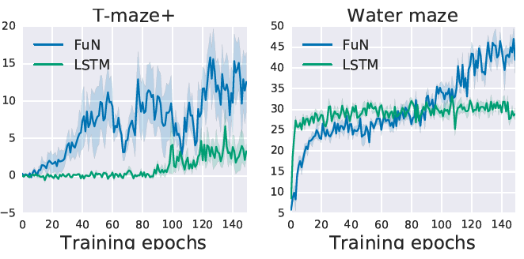
Experiments
Water maze is a circular pool of water with a concealed platform at unknown location.
T-maze+ is an enhaned T-maze such that lenghs of the corridors are variable.
Figure on the left shows that FuN learns meaningful subpolicies (rightmost graph).
So that it outperforms LSTM.
Notes:
LSTM does kinda random walk.
FuN starts with a circular path having a large radius, as the time progresses it decreases the radius, there is a strategy here.

Slide 18
Experiments
Analysis of Other Variants of FuN
Non-Feudal FuN: Manager’s output $g$ is trained with graidents coming from the worker, no intrinsic reward is used
Pure-Feudal FuN: Worker is trained only with intrinsic reward.
Manager via PG: $g$ is learnt using standard policy gradient approach with the manager emitting the mean of a Gaussian distribution from which $g$ are sampled.
Absolute goals: Absolute goals are used rather than directional goals.
Proposed FuN performs better than other variations.

Slide 19
Experiments
Dilated vs. non-dilated.
Reward vs. $α$
Action repeat. Sharpens prob. dist. of state space.

Slide 20
Conclusion & Future Work
An architecture to decompose agent’s behaviour into meningful pieces and using them to acquire new behaviours.
Long-term memory while being reactive to the moment.
Constructing deeper hierarchies.
Using learnt behaviours to acquire more complex skills.

Slide 21
Questions

