Slide 1
Generative Adversarial Nets
İlke Çuğu 1881739

Slide 2
NIPS 2014
Ian Goodfellow et al.

Slide 3
At a glance
(http://www.kdnuggets.com/2017/01/generative-adversarial-networks-hot-topic-machine-learning.html)

Slide 4
Idea Behind GANs

Slide 5
Zero-sum Games
Default Example:
Matching Pennies

Slide 6
Game of Matching Pennies
Player 2
Player 1

Slide 7
GAN Training
... from blog post of Adam Geitgey[1]

Slide 8
GAN Training

Slide 9
GAN Training

Slide 10
GAN Training

Slide 11
GAN Training

Slide 12
GAN Training

Slide 13
GAN Training

Slide 14
Training a GAN

Slide 15
Discriminator
From minibatch of data
From minibatch of noise

Slide 16
Generator

Slide 17
Summing Up
k times

Slide 18
In Practice
D1 = D(x) (D wants it to be near 1)
D2 = D(G(z)) (D wants it to be near 0)

Slide 19
Pitfall

Slide 20
Mode Collapse
Also known as the Helvetica scenario
The generator learns to map several different input z values to the same output point
Does not seem to be caused by any particular cost function

Slide 21
Mode Collapse [2]

Slide 22
2 Sample Applications

Slide 23
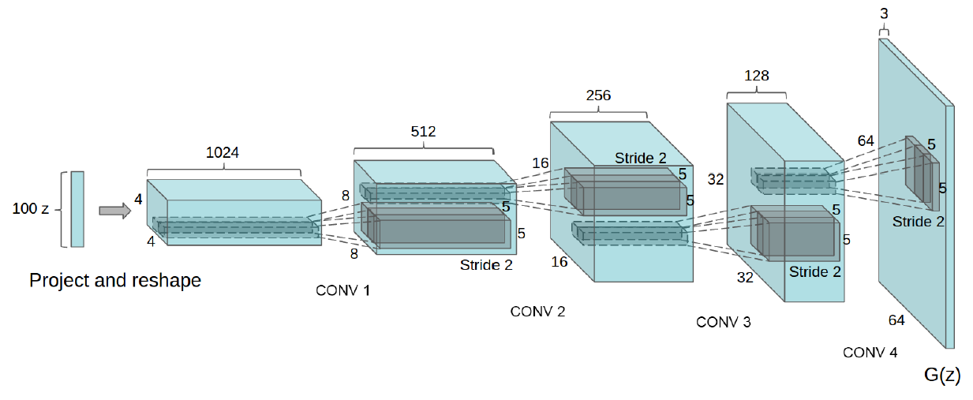
Deep Convolutional GAN [3]
2015 – Radford et al.
Note: No FC & Pooling

Slide 24
Deep Convolutional GAN [3]

Slide 25
Deep Convolutional GAN [3]

Slide 26
Deep Convolutional GAN [3]

Slide 27
Single Image Super-Resolution [4]
2016 - Ledig et al.
GAN + ResNet

Slide 28
Single Image Super-Resolution [4]

Slide 29
The End

Slide 30
References
[1] https://medium.com/@ageitgey/abusing-generative-adversarial-networks-to-make-8-bit-pixel-art-e45d9b96cee7#.9lngjtkdr
[2] Reed, S., et al. Generating interpretable images with controllable structure. Technical report, 2016. 2, 2016.
[3] Radford, Alec, Luke Metz, and Soumith Chintala. "Unsupervised representation learning with deep convolutional generative adversarial networks." arXiv preprint arXiv:1511.06434 (2015).
[4] Ledig, Christian, et al. "Photo-realistic single image super-resolution using a generative adversarial network." arXiv preprint arXiv:1609.04802 (2016).

