Slide 1
Introduction to Operating Systems Inter-process Communication
Most of the following slides are adapted from slides that were downloaded on the net.

Slide 2
Inter-process Communication (IPC)
Cooperating processes or threads need inter-process communication (IPC)
Data transfer
Sharing data
Event notification
Resource sharing
Process control
Processes may be running on one or more computers connected by a network.
The method of IPC used may vary based on the bandwidth and latency of communication between the threads, and the type of data being communicated.
IPC may also be referred to as inter-thread communication and inter-application communication.

Slide 3
IPC mechanisms
IPC mechanisms
Signals
Pipes
Unnamed Pipes
Named Pipes of FIFOs
Message Queues
Shared Memory
Mapped files
Remote Procedure Calls (RPC)
Sockets (in network course)
Semaphores (later)

Slide 4
IPC - Signals
Signals: software generated interrupts that are sent to a process when an event happens
Kill
^C
Expensive
Limited: only 31 signals.
Signal handlers run asynchronously

Slide 5
IPC - (Unnamed) Pipes
A unidirectional, FIFO, unstructured data stream of fixed maximum size.
int pipe (int * filedes)
filedes[0] for read
filedes[1] for write
P
P
P
Data
P
P

Slide 6
IPC – (Unnamed) Pipes
Applications:
in shell passing output of one program to another program
e.g. cat file1 file2 | sort
Limitations:
cannot be used for broadcasting;
Data in pipe is a byte stream – has no structure
No way to distinguish between several readers or writers
Implementation
by using file system mechanisms, sockets or STREAMS,
Alternative: FIFO – named pipe
may be accessed by unrelated processes, is persistent, has a name;
but must be explicitly deleted when not used, less secure than pipe,

Slide 7
IPC – Unnamed Pipes vs FIFOs
Unnamed pipes
cat myfile | grep key | sort | lpr
The parent process (the shell or shell script that creates the pipes) also spawns the child processes that access the pipe
cat, grep, sort, and lpr in this case
Note: the shell or script process that sets up the pipes CANNOT access the pipes itself!

Slide 8
IPC - Pipes and FIFOs
FIFOs can be accessed by any process that “knows the name”
Pipes are temporary in the sense that they cease to exist when no process has them open
FIFOs or named pipes, are special files that persist even after all processes have closed them
A FIFO has a name and permissions just like an ordinary file and appears in a directory listing
Any process with the appropriate permissions can access a FIFO
A user creates a FIFO by executing the mkfifo command from a command shell or by calling the mkfifo() function from within a program

Slide 9
FIFO Creation in shell
FIFO are created using the mknod or the mkfifo commands
mkfifo name
mkfifo –m mode name
mknod name p
Make sure you remove (rm) your pipes after use!

Slide 10
Using Named Pipes
First, create your pipes
mknod pipe1 p
mknod pipe2 p
mknod pipe3 p
Then, attach a data source to your pipes
ls -l >> pipe1 &
cat myfile >> pipe2 &
who >> pipe3 &
Then, read from the pipes with your reader process
cat < pipe1 | lpr
spell < pipe2
sort < pipe3
Finally, delete your pipes
rm pipe[1-3]
Notes:
Note: >> to append to pipe
& for background execution

Slide 11
IPC – FIFO – mkfifo()
int mkfifo(const char *path, mode_t mode);
The mkfifo() function creates a new FIFO special file corresponding to the path name specified in the path parameter
The mode parameter specifies the permissions for the newly created FIFO
If successful, the function returns zero; otherwise, it returns –1 and sets errno

Slide 12
Message sending
#define FIFO_PERMISSIONS (S_IRUSR | S_IWUSR) int status; status = mkfifo("client.fifo", FIFO_PERMISSIONS); /* create FIFO*/ if (status == -1) perror("Failed to create FIFO"); int status; status = unlink("client.fifo"); /* delete FIFO */ if (status == -1) perror("Failed to unlink FIFO");

Slide 13
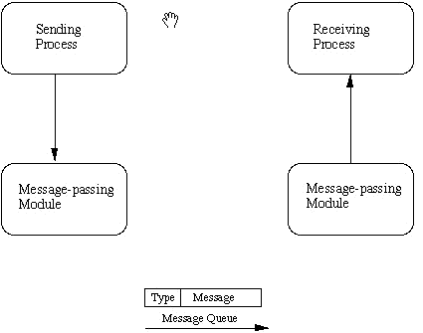
IPC - Message Queues
The sending process places via some (OS) message-passing module a message onto a queue which can be read by another process.
Each message is given an identification or type so that processes can select the appropriate message.
Process must share a common key in order to gain access to the queue in the first place
Messages: explicit length, different types.

Slide 14
IPC - Message Queues
Before a process can send or receive a message, the queue must be initialized through the msgget().
Operations to send and receive messages are performed by the msgsnd() and msgrcv() functions, respectively.
In Non-blocking message passing allow for asynchronous message transfer
the process is not suspended as a result of sending or receiving a message.
In blocking or synchronous message passing
the sending process blocks until the message has been transferred or has even been acknowledged by a receiver.

Slide 15
Message sending
#define MSGSZ 128
typedef struct msgbuf { /*msg structure */
long mtype;
char mtext[MSGSZ];
} message_buf;
main(){
int result, msgid, msgflg = IPC_CREAT | 0666;
key_t key;
message_buf sbuf;
size_t buf_length;
key = 1234;
msqid = msgget(key, msgflg);
sbuf.mtype = 1; /*send a msg of type 1 */
strcpy(sbuf.mtext, "Did you get this?");
buf_length = strlen(sbuf.mtext) + 1 ;
/* send msg */
result = msgsnd(msqid, &sbuf, buf_length, IPC_NOWAIT);
printf("Message: \"%s\" Sent\n", sbuf.mtext);
exit(0);
}

Slide 16
Message receiving
#define MSGSZ 128
typedef struct msgbuf { /* msg struct */
long mtype;
char mtext[MSGSZ];
} message_buf;
main(){
int msqid;
key_t key;
message_buf rbuf;
key = 1234;
msqid = msgget(key, 0666);
/* receive msg */
result = msgrcv(msqid, &rbuf, MSGSZ, 1, 0);
/* print msg */
printf("%s\n", rbuf.mtext);
exit(0);
}
The Message queue is opened with msgget (message flag 0666) and the same key as message_send.c.
A message of the same type 1 is received from the queue with the message ``Did you get this?'' stored in rbuf.mtext.

Slide 17
Discussion of message queues
Msgq are more versatile than pipes and address some of their limitations,
Can transmit msgs as structured entities
Msg type can be used to specify e.g. priorities, urgency, designate recipient,
Can be used for small amount of data – expensive for large amounts
Kernel does not help with recipient specification,
Cannot broadcast msgs,
Allow selective retrieval of msgs by type,
STREAMS are now more popular for msg transfer.

Slide 18
IPC- Shared Memory
Allows multiple processes to share virtual memory space.
Fastest but not necessarily the easiest (synchronization-wise) way for processes to communicate with one another.
Process A
Process B
0x30000
0x50000
0x50000
Shared memory
region
0x70000

Slide 19
IPC- Shared Memory
One process creates or allocates the shared memory segment.
size and access permissions set at creation.
The process then attaches the shared segment,
causing it to be mapped into its current data space.
If needed, the creating process then initializes the shared memory.
Once created, and if permissions permit,
other processes can gain access to the shared memory segment and map it into their data space.
Each process accesses the shared memory relative to its attachment address.
For each process involved, the mapped memory appears to be no different from any other of its memory addresses.

Slide 20
POSIX Shared Memory
Write process
Create shared memory segment
segment id = shmget(key, size, IPC_CREAT);
Attach shared memory to its address space
addr= (char *) shmat(id, NULL, 0);
write to the shared memory
*addr = 1;
Detach shared memory
shmdt(addr);
Read process
segment id = shmget(key, size, 0666);
addr= (char *) shmat(id, NULL, 0);
c= *addr;
shmdt(addr);

Slide 21
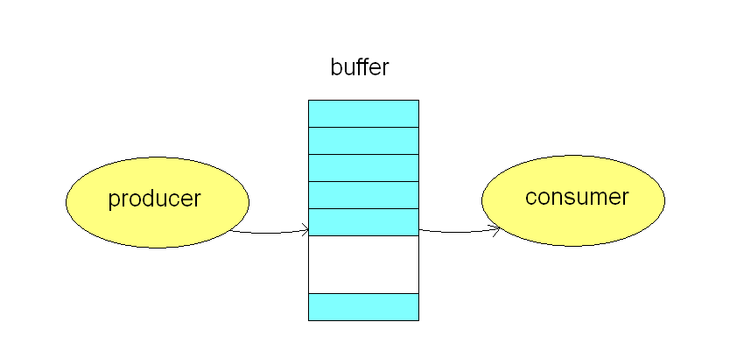
Example: Producer-Consumer Problem
Producer process produces information that is consumed by a consumer process
e.g. print utility places data and printer fetches data to print.

Slide 22
Server code for producer
main() {
char c; int shmid; key_t key=5678;
char *shm, *s;
/* Create the segment. */
if ((shmid = shmget(key, 27, IPC_CREAT | 0666)) < 0) {
printf("server: shmget error\n");
exit(1);
}
/* Attach the segment to our data space. */
if ((shm = shmat(shmid, NULL, 0)) == (char *) -1) {
printf("server: shmat error\n");
exit(1);
}
/* Output data*/
s = shm;
for (c = 'a'; c <= 'z'; c++)
*s++ = c;
/* Wait the client consumer to respond*/
while (*shm != '*') sleep(1);
shmdt(shm);
exit(0);
}

Slide 23
Client code for consumer
main(){
int shmid; key_t key=5678;
char *shm, *s;
/* Locate the segment. */
if ((shmid = shmget(key, SHMSZ, 0666)) < 0) {
printf("client: shmget error\n"); exit(1);
}
/* attach the segment to our data space.*/
if ((shm = shmat(shmid, NULL, 0)) == (char *) -1) {
printf("client: shmat error\n"); exit(1);
}
/* Read what the server put in the memory, and display them*/
for (s = shm; *s != ‘z’; s++)
putchar(*s);
putchar('\n');
/* Finally, change the first character of the segment to '*‘ */
*shm = '*';
exit(0);
}

Slide 24
Generating a common key..
key_t ftok(const char *path, int id); /*generate an IPC key*/
The ftok() function shall return a key based on path and id that is usable in subsequent calls to msgget(), semget(), and shmget().
The ftok() function shall return the same key value for all paths that name the same file, when called with the same id value, and return different key values when called with different id values or with paths that name different files existing on the same file system at the same time.
Only the low-order 8-bits of id are significant.
The behavior of ftok() is unspecified if these bits are 0.

Slide 25
IPC - Shared memory
Advantages
good for sharing large amount of data
very fast,
Limitation
no synchronization provided
applications must create their own
Alternative
mmap() system call, which maps file into the address space of the caller,

Slide 26
IPC- mmap() using a File as Shared Memory
mmap() system call can be used to map a file to a process's virtual memory address space.
In many ways mmap() is more flexible than its shared memory system call counterpart.
Once a mapping has been established, standard system calls rather than specialized system calls can be used to manipulate the shared memory object.
Unlike memory, the contents of a file are nonvolatile and will remain available even after a system has been shut down (and rebooted).

Slide 27
Using a File as Shared Memory
void *mmap(void *start, size_t length, int prot, int flags, int fd, off_t offset);
start is the address for attachment.
mostly set to 0, which directs the system to choose a valid attachment address.
length: The number of bytes to be attached
prot: used to set the type of access (protection) for the segment.
fd,: open file descriptor.
Once the mapping is established, the file can be closed.
offset,: set the starting position for the mapping.
If successful,
returns a reference to the mapped memory object.
else returns MAP_FAILED
which is actually the value -1 cast to a void *.
int munmap(void *start, size_t length);
Called automatically when the process quits.

Slide 28
Writing to a file through mmap()
#define NUMINTS (1000)
#define FILESIZE (NUMINTS * sizeof(int))
int main(int argc, char *argv[])
{
int i, fd, result;
int *map; /* mmapped array of int's */
fd = open("/tmp/j", O_RDWR | O_CREAT | O_TRUNC, (mode_t)0600);
/*Stretch the file to the size of the (mmapped) array of ints */
result = lseek(fd, FILESIZE-1, SEEK_SET);
/* Write "" to resize the file */
result = write(fd, "", 1);
map = mmap(0, FILESIZE, PROT_READ|PROT_WRITE,MAP_SHARED,fd, 0);
/* Now write int's to the file as if it were memory */
for (i = 1; i <=NUMINTS; ++i)
map[i] = 2 * i;
result = munmap(map, FILESIZE);
/* Un-mapping doesn't close the file, */
close(fd);
return 0;
}

Slide 29
Reading from a file through mmap()
#define NUMINTS (1000)
#define FILESIZE (NUMINTS * sizeof(int))
int main(int argc, char *argv[])
{
int i,fd, result;
int *map; /* mmapped array of int's */
fd = open("/tmp/j", O_RDONLY);
map = mmap(0, FILESIZE, PROT_READ, MAP_SHARED, fd, 0);
/* Read the file int-by-int from the mmap */
for (i = 1; i <=NUMINTS; ++i)
printf("%d: %d\n", i, map[i]);
result = munmap(map, FILESIZE)
close(fd);
return 0;
}

Slide 30
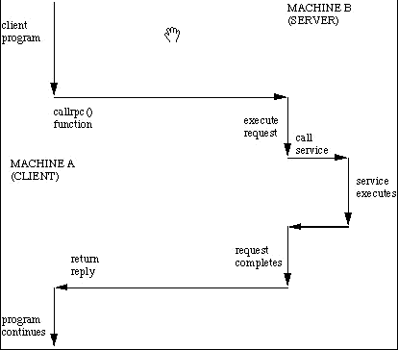
IPC - Remote Procedure Calls (RPCs)
An RPC is analogous to a function call.
When an RPC is made, the calling arguments are passed to the remote procedure and the caller waits for a response to be returned from the remote procedure.

Slide 31
Sequence of events during a RPC
The client calls the client stub.
The call is a local procedure call, with parameters pushed on to the stack in the normal way.
The client stub packs the parameters into a message and makes a system call to send the message.
Packing the parameters is called marshalling.
The client's local operating system sends the message from the client machine to the server machine.
The local operating system on the server machine passes the incoming packets to the server stub.
The server stub unpacks the parameters from the message .
Unpacking the parameters is called unmarshalling.
Finally, the server stub calls the server procedure.
The reply traces the same steps in the reverse direction.

Slide 32
Differences between using local and remote procedure calls
Remote calls can fail because of unpredictable network problems.
Also, callers generally must deal with such failures without knowing whether the remote procedure was actually invoked.
Idempotent procedures (those that have no additional effects if called more than once) are easily handled, but enough difficulties remain that code to call remote procedures is often confined to carefully written low-level subsystems.

Slide 33
Interface Description Language
To let different clients access servers, a number of standardized RPC systems have been created.
Most of these use an interface description language (IDL) to let various platforms call the RPC.
The IDL files can then be used to generate code to interface between the client and server.
The most common tool used for this is RPCGEN.

Slide 34
IPC - Sockets
Sockets provide point-to-point, two-way communication between two processes.
A socket is an endpoint of communication to which a name can be bound. It has a type and one or more associated processes.
Sockets exist in communication domains.
A socket domain is an abstraction that provides an addressing structure and a
The UNIX domain provides a socket address space on a single system.
UNIX domain sockets are named with UNIX paths.
can be used to communicate between processes on a single system.
Sockets can also be used to communicate between processes on different systems.
The socket address space between connected systems is called the Internet domain.
Internet domain communication uses the TCP/IP internet protocol suite.

Slide 35
Socket types
Define the communication properties visible to the application.
A stream socket
provides two-way, sequenced, reliable, and unduplicated flow of data much like a telephone conversation (TCP)
A datagram socket
supports a two-way flow of messages much like passing letters back and forth in the mail. (UDP)
A sequential packet socket
provides a two-way, sequenced, reliable, connection, for datagrams of a fixed maximum length.
A raw socket
provides access to the underlying communication protocols.

Slide 36
Socket creation and naming
int socket(int domain, int type, int protocol)
Domain: AF_INET | AF_UNIX | …
Type: SOCK_STREAM | SOCK_DGRA | …
In the UNIX domain, a connection is usually composed of one or two path names.
In the Internet domain, a connection is composed of local and remote addresses and local and remote ports.

Slide 37
Server steps
Create a socket with the socket() system call.
Bind the socket to an address using the bind() system call. For a server socket on the Internet, an address consists of a port number on the host machine.
Listen for connections with the listen() system call.
Accept a connection with the accept() system call. This call typically blocks until a client connects with the server.
Send and receive data using the read() and write() system calls.

Slide 38
Socket server - UNIX
#define ADDRESS "mysocket" /* addr to connect */
char *strs = "This is the string from the server.\n";
main(){
char c; FILE *fp;int fromlen;
register int i, s, ns, len;
struct sockaddr_un saun, fsaun;
/* create a UNIX domain stream socket */
s = socket(AF_UNIX, SOCK_STREAM, 0))
saun.sun_family = AF_UNIX;
strcpy(saun.sun_path, ADDRESS);
unlink(ADDRESS);
len = sizeof(saun.sun_family) + strlen(saun.sun_path);
result = bind(s, &saun, len);/*bind the address to the socket */
result = listen(s, 5); /* listen on the socket */
ns = accept(s, &fsaun, &fromlen)) /* Accept a connection */
fp = fdopen(ns, "r"); /* open the connection */
/* send the string to the client */
send(ns, strs, strlen(strs), 0);
/* read from the server */
while ((c = fgetc(fp)) != EOF) {
putchar(c);
if (c == '\n’) break;
}
close(s);
exit(0);
}

Slide 39
Socket client - UNIX
#define ADDRESS "mysocket" /* addr to connect */
char *strs = "This is the first string from the client.\n";
main(){
char c; FILE *fp; register int i, s, len;
struct sockaddr_un saun;
/* create a UNIX domain stream socket */
s = socket(AF_UNIX, SOCK_STREAM, 0);
saun.sun_family = AF_UNIX;
strcpy(saun.sun_path, ADDRESS);
len = sizeof(saun.sun_family) + strlen(saun.sun_path);
result= connect(s, &saun, len);
fp = fdopen(s, "r");
/* read from the server */
while ((c = fgetc(fp)) != EOF) {
putchar(c);
if (c == '\n') break;
}
/* Now we send some strings to the server.*/
send(s, strs, strlen(strs), 0);
close(s);
exit(0);
}

Slide 40
POSIX
Portable Operating System Interface:
a family of standards specified by the IEEE for maintaining compatibility between operating systems.
POSIX defines the application programming interface (API), along with command line shells and utility interfaces, for software compatibility with variants of Unix and other operating systems
Fully POSIX-compliant
AIX, BSD/OS, Solaris, QNX, OS X, ….
Mostly POSIX-compliant
GNU/Linux
FreeBSD, VxWorks
CygWin for Windows
….

Slide 41
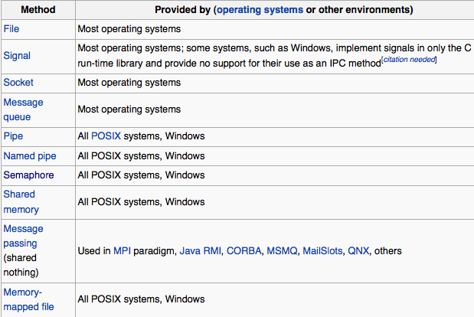
IPC support provided by OS or other envs.

Slide 42
More info and details available at
Programming in C UNIX System Calls and Subroutines using C. A. D. Marshall 1994-2005
http://www.cs.cf.ac.uk/Dave/C/CE.html

